Slide 1

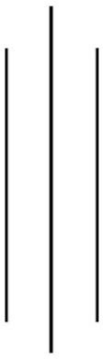
Tribhuvan University
Bhaktapur Multiple Campus
Dudhpati-1 Bhaktapur, Nepal
"Lab Report : Computer Architecture"(CSC213)
Semester: III
Name: Mark Dangal
Roll No: 26
Level: B.Sc. CSIT
Submitted to: Jina Chaudhary
Submission Date:
Signature of subject teacher

Slide 2
Table of content
S.N. | Program to Implement: | Date : | Signature:
1
2
3
4
5
6
7
8
9
10
11
12
14
15

Slide 3
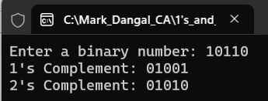
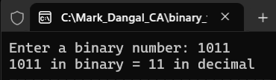
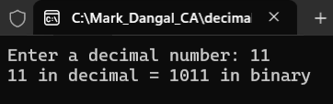
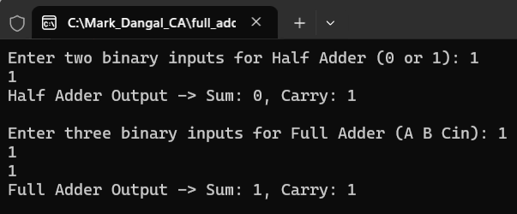
1’s and 2’s complement
Binary to decimal
Decimal to Binary
Half adder and full adder

Slide 4
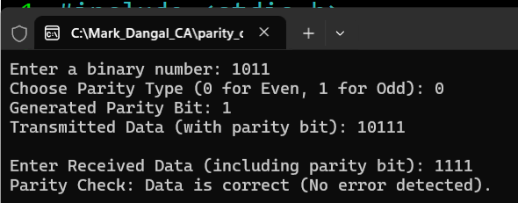
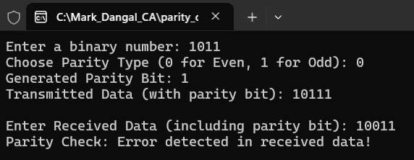
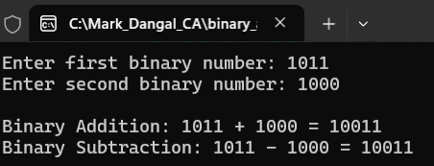
Case of no error detected
Case of error detection
Binary addition and subtraction

